Slide 1
INSTRUMENTS IN OPHTHALMOLOGY

Slide 2
INTRODUCTION
Instruments are tools required for examination in ophthalmology to arrive at a diagnosis.
Some are required to carry out procedures while others are necessary for treatment

Slide 3
TYPES OF INSTRUMENTS
Various types of instruments are used in ophthalmology.
These range from simple ones like the pen torch to sophisticated ones like the optical computer tomography (OCT).

Slide 4
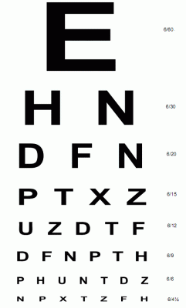
TYPES OF INSTRUMENTS
A Snellen chart is an eye chart that can be used to measure visual acuity. Snellen charts are named after the Dutch ophthalmologist Herman Snellen who developed the chart in 1862

Slide 5

TYPES OF INSTRUMENTS
Pen torch: This is a very useful tool in the hand of any eyecare practitioner. It is used to assess the anterior segment of the eyeand ocular adnexa

Slide 6
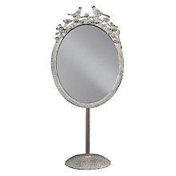
TYPES OF INSTRUMENTS
Reflecting Mirror:The plain standing mirror is used in the eyeclinic to ingrease the distance from the Snellen’s chart in a room less than 6 metres

Slide 7
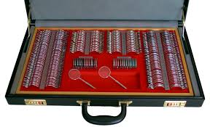
TYPES OF INSTRUMENTS
Trial lens set: The trial lens set is a box that contains the concave, convex, cylindrical and prism lenses.
It also contains occluders, pinholes and Jackson Cross cylinders
The contents of the box are used for refraction

Slide 8
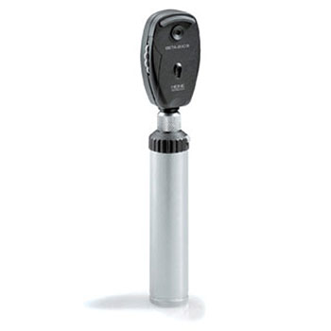
TYPES OF INSTRUMENTS
Direct Ophthalmoscopes:
The direct ophthalmoscope is commonly used for routine examination of the fundus of the eye, especially when a slit lamp cannot be used.
It is small, easily portable and can also be used to examine the more anterior parts of the eye.

Slide 9
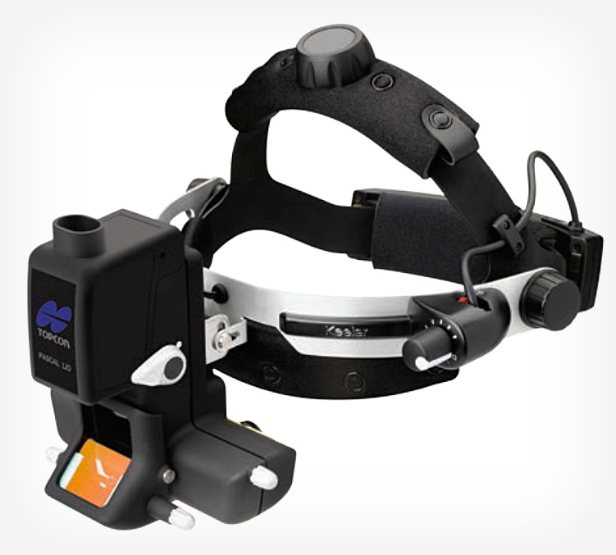
TYPES OF INSTRUMENTS
Indirect Ophthalmoscope:
The indirect ophthalmoscope offers an alternative means of examining the retina and vitreous, and gives a very different view of the retina compared with that obtained with the direct ophthalmoscope. Both instruments have their place and should be used to complement each other during the clinical examination of the eye

Slide 10
Summary of the optical properties of the direct and indirect ophthalmoscope
 | DIRECT | INDIRECT
Image Field of view Magnification Binocularity Influence of patient's refractive error Teaching facility | Not Inverted Small (6°) Large ( × 15) Not available Large None | Vertically and horizontally inverted Large (25°) Small ( × 3 [+20D]) × 5 [+13D]) Stereoscopic view Small Teaching mirror
.

Slide 11
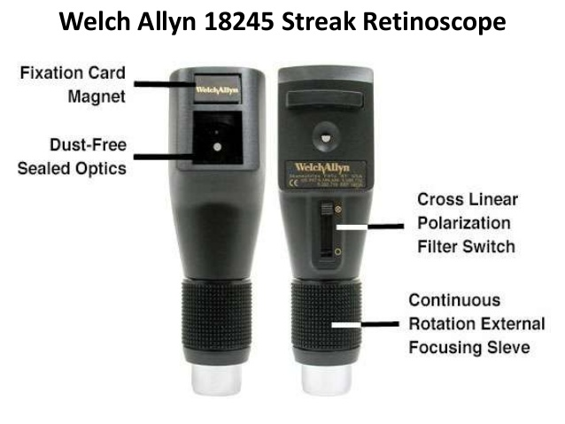
TYPES OF INSTRUMENTS
The Retinoscope:
An accurate objective measurement of the refractive state of an eye can be made using the retinoscope. The technique is called retinoscopy.

Slide 12
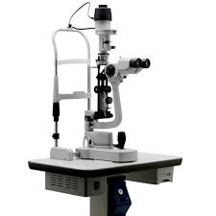
TYPES OF INSTRUMENTS
Slit Lamp:
The routine method of examining the outer segment of the eye is with a slit lamp. It consists essentially of a relatively low-powered binocular compound microscope which is linked to an adjustable bright light source.
The instrument is known as a slit lamp because in everyday use the illumination is arranged so that a narrow vertical slit of light is projected on to the eye.

Slide 13
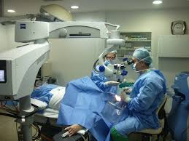
TYPES OF INSTRUMENTS
Operating Microscope: This is used in the theatre for microsurgical procedures

Slide 14
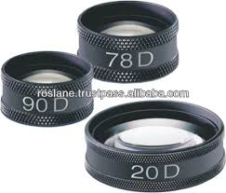
TYPES OF INSTRUMENTS
90 D and 78 D Lenses :
The principle of the indirect ophthalmoscope has been adapted so that the real image of the retina formed by the condensing lens may be viewed through a slit lamp microscope.
For this purpose high power condensing lenses are used, 90 D or 78 D, in order to shorten the light path and bring the retinal image within the focal range of the slit lamp

Slide 15
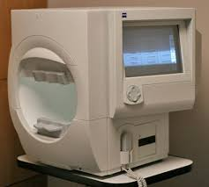
Visual Field Analyser: This is used in measuring the visual field in patients with glaucoma and other optic nerve damage

